Slide 1

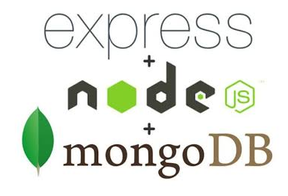

CRUD Application using nodejs, express, mongoDB

